Slide 1
DRDO Cryptography and Cryptanalysis
Implement Caesar Cipher in Java

Slide 2

Defence Research and Development organisation (DRDO)
Defence Research and Development Organisation (DRDO) is a defence R&D hub which develops defence technologies, systems/products that are required for Indian Armed Forces.
Established in 1998,headquartered in New Delhi , India.
DRDO has firm determination to make the nation strong and self-reliant in terms of science and technology, especially in the field of military technologies.

Slide 3
Defence Research and Development organisation (continuing…..)
Agni and Prithvi series of missiles, light combat aircraft, Tejas, multi-barrel rocket launcher, Pinaka, air defence system, Akash are the some of india’s key military technologies.
Today, DRDO is a network of more than 50 laboratories which are deeply engaged in developing defence technologies.
aeronautics, armaments, electronics, combat vehicles, engineering systems, instrumentation, missiles, advanced computing and simulation, special materials, naval systems, life sciences, training, information systems and agriculture are the technologies DRDO covering.

Slide 4
CRYPTOLOGY
Cryptology is the science of secure communications.
Cryptography creates messages with hidden meaning.
Two parts of cryptology :
cryptography
cryptanalysis

Slide 5
TABLE OF CONTENT
plaintext
Ciphertext
Encryption
Decryption
Cryptology
Cryptography
key

Slide 6
CRYPTOGRAPHY
It is the study and practice of techniques for secure communication in the presence of third parties called adversaries.
It deals with developing and analyzing protocols which prevents malicious third parties from retrieving information being shared between two entities.
Encryption > plain text to cipher text > Decryption
Confidentiality, Integrity, Authentication and Non-repudiation are core principles of .cryptography.

Slide 7
CRYPTANALYSIS
Cryptanalysis is the study of methods for obtaining the meaning of encrypted information, without access to the secret information that is typically required to do so.
This involves finding a secret key.
This is the practice of codebreaking or cracking the code.
It is the study of methods for obtaining the meaning of encrypted information, without access to the secret information.

Slide 8
Table of content (continuing…..)
Plaintext :
Plaintext is a message to be communicated.
Ciphertext :
A disguided version of a plaintext.
Encryption :
The process of turning plaintext into ciphertest

Slide 9
Table of content (continuing…..)
Decreption :
The process o turning ciphertext into plaintext
Cryptology:
The study of encryption and decryption.
Cryptography :
The application of Cryptology.

Slide 10
CAESAR CIPHER
In cryptography, a Caesar cipher, also known as the shift cipher, Caesar's code or Caesar shift, is one of the simplest and most widely known encryption techniques.
It is a type of substitution cipher in which each letter in the plaintext is replaced by a letter some fixed number of positions down the alphabet.
For example with a shift of 3, A would be replaced by D, B would become E, and so on.

Slide 11
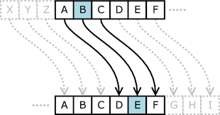

CAESAR CIPHER (continued…..)
According to the scheme,
A = 0, B = 1,…, Z = 25.
Encryption of a letter by a shift n
can be described mathematically
As :

Slide 12

CAESAR CIPHER (continued…..)
(Encryption Phase with shift n)
According to the scheme, A = 0, B = 1,…, Z = 25.
Decryption of a letter by a shift n
can be described mathematically
As :

Slide 13
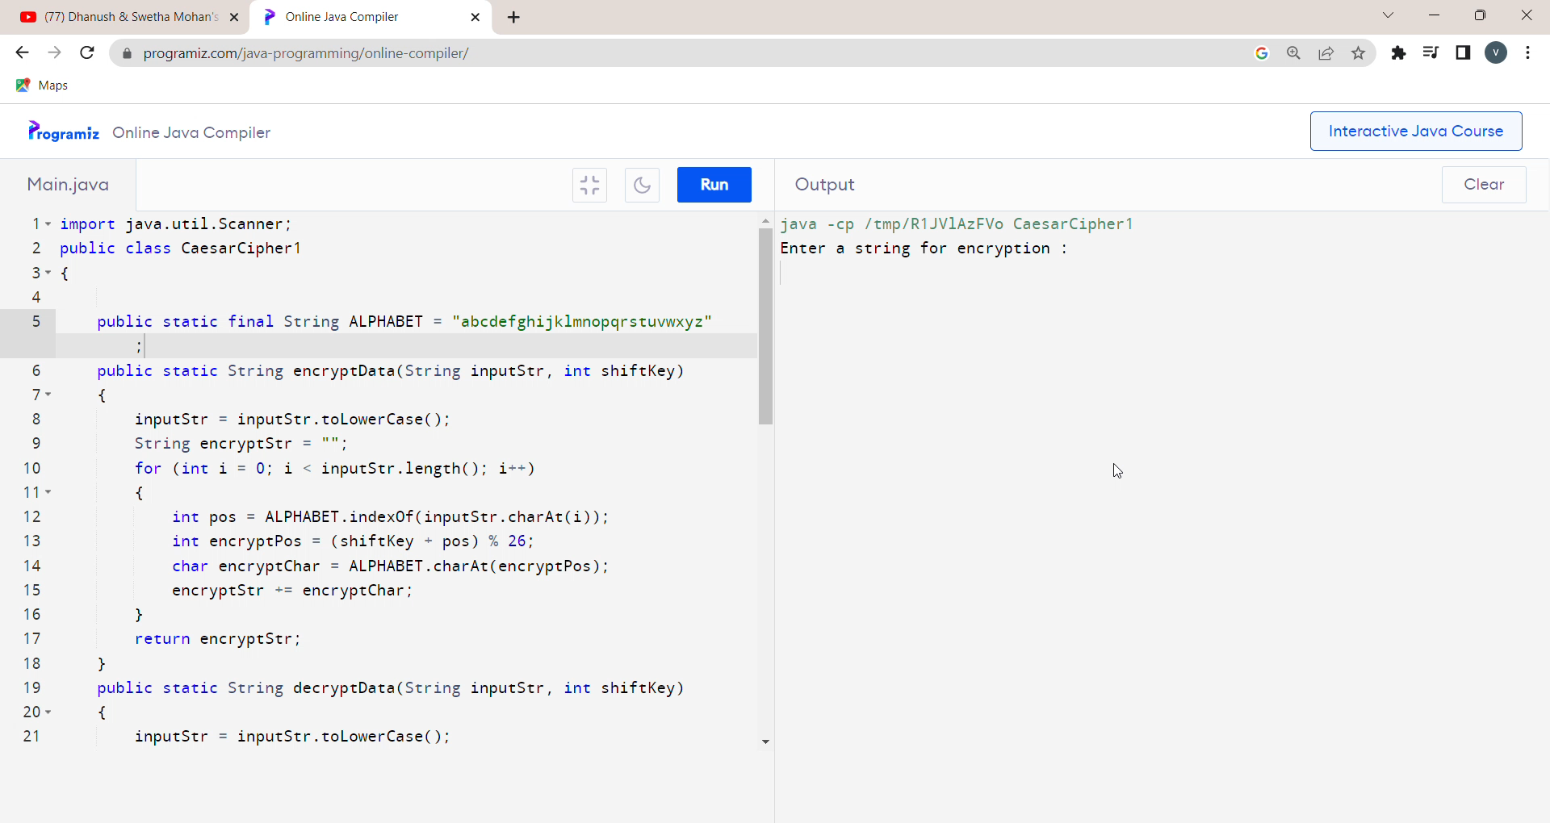
DEMANSTRATION

Slide 14
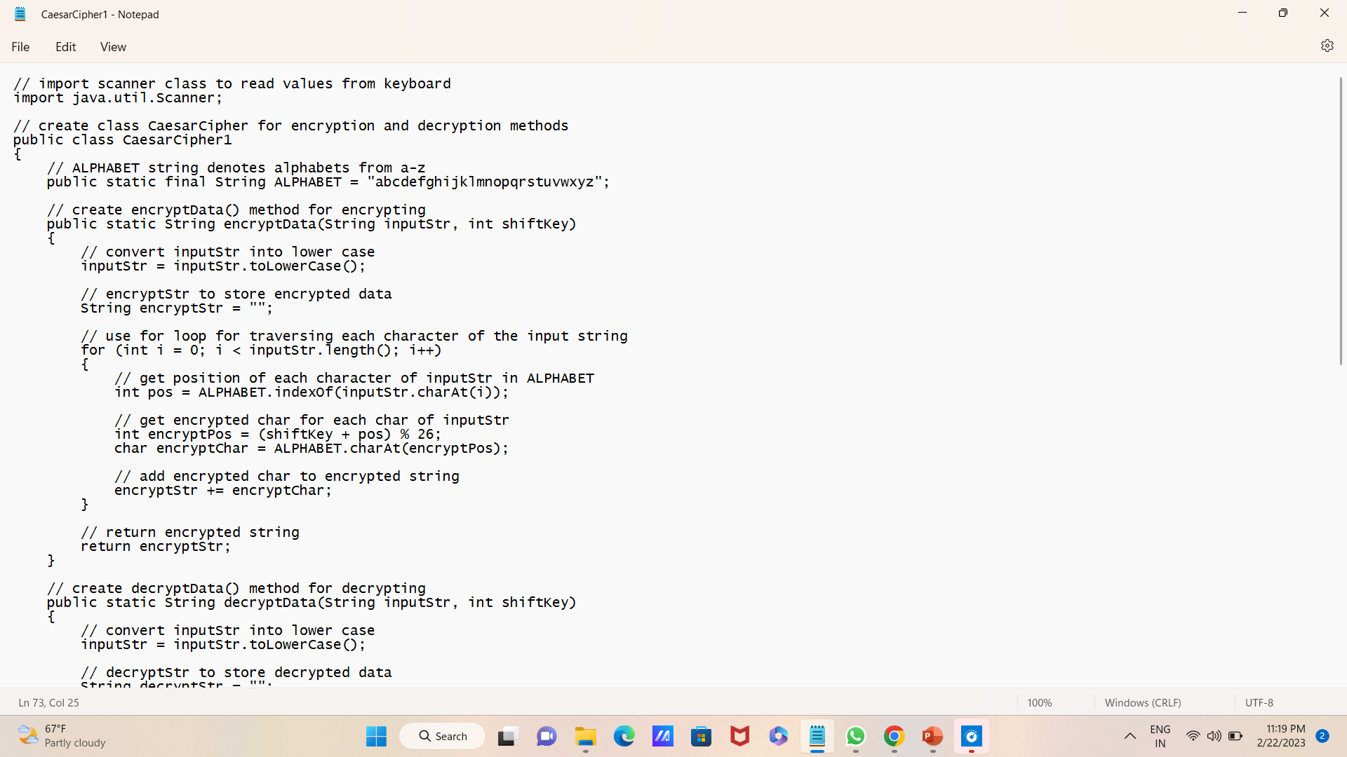
DEMONSTRATION

Slide 15
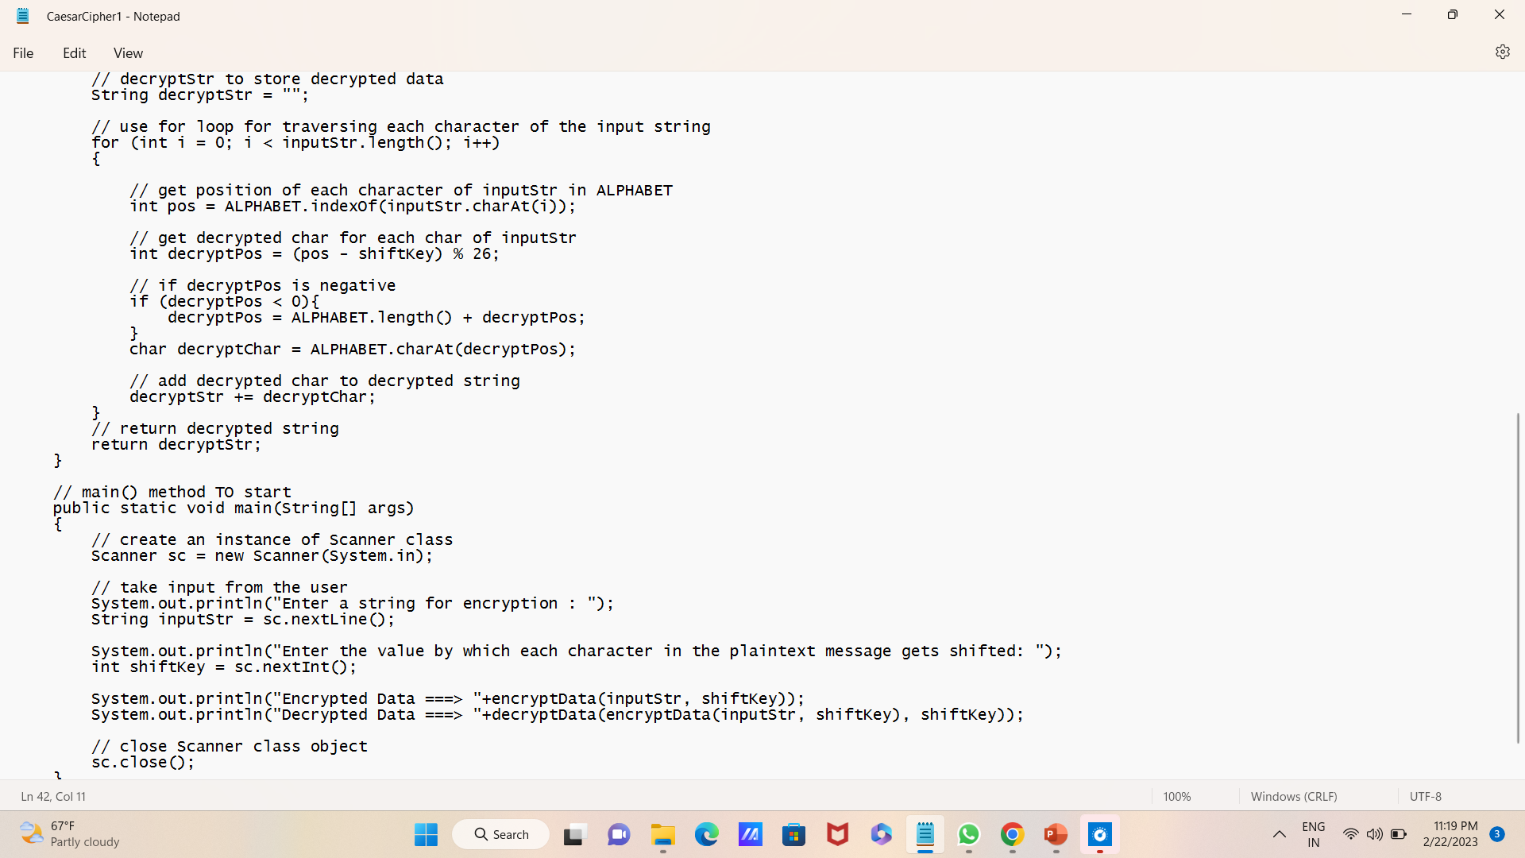

Slide 16
THANK YOU
Vijay kumar Y
yvijaykumar200210@gmail.com

